Slide 1





Data Science with Python
Sajjad Hussain
@saz2nitk
https://github.com/saz2nitk
https://www.linkedin.com/in/sajjad-hussain-86188816/
saz2nitk@gmail.com

Slide 2
Who am I?
Data Science Lead, REM, Trafigura
Former Co-founder at Heuristech Labs
Full Stack Data Scientist
Experience
Data Science
Fintech
NLP
E-commerce
Structured & Unstructured Data

Slide 3
What will we cover
Will you become a Full Stack Data Scientist after this session?
No
What do we achieve then?
You’ll learn how to become a Data Scientist
You’ll know if Data Science interests you
Major Topics
Fundamentals of Data Science
Python Programming
Some Machine Learning Algorithm
Implementing one Data Science Solution

Slide 4
What is Data Science
Data Science vs Data Analysis
There is a fundamental difference between the two terms
What do Data Scientists do?
Solve Problems
Day-to-day Activity
Talk to business, understand problem
Analyse data and find useful insights
Build models, Deploy and Maintain them

Slide 5

Major Skills

Slide 6
Skillset
Programming
Python
Tools
Numpy
Mathematics
Deployment
Machine Learning
Classification
R
Scala
Java
C/C++
NLTK
CoreNLP
Rapid Miner
Weka
TextBlob
Spacy
Tensorflow
Probability
Calculus
Vectors
Statistics
Clustering
Regression
Anomaly Detection
Recommender System
Pattern Matching
Computer Vision
API
Linux
Cloud Services
AWS/Azure/IBM
Docker
Kubernetes
Big Data
Hadoop
Spark

Slide 7
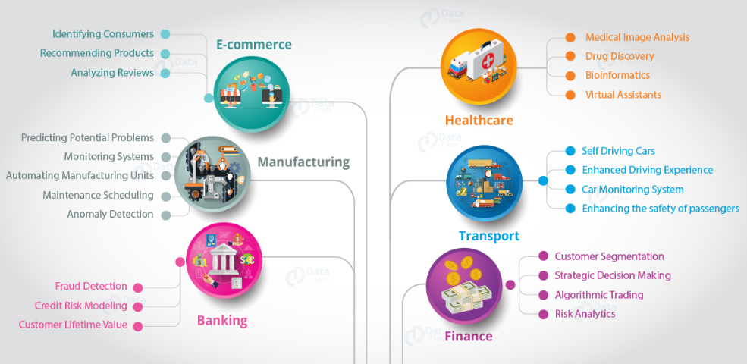
Data Science Applications

Slide 8
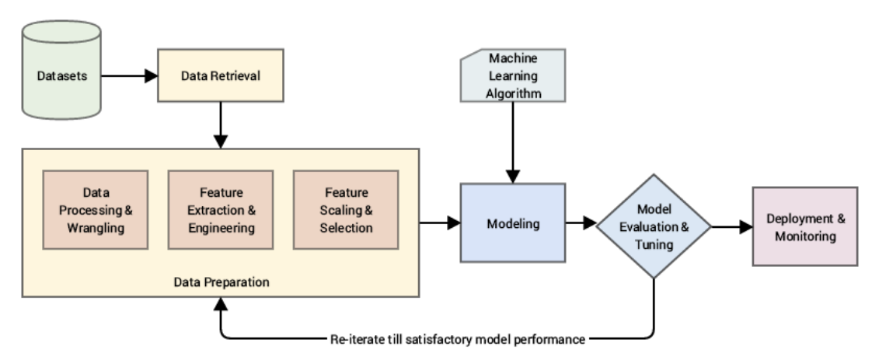
Machine Learning Pipeline

Slide 9
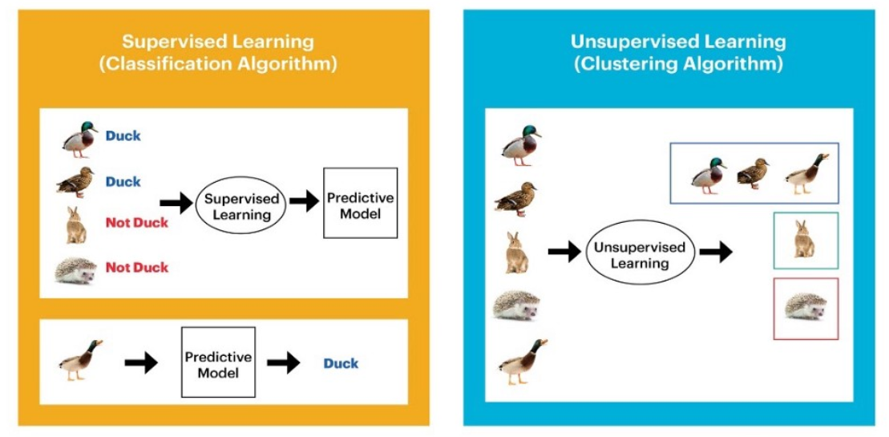
Machine Learning Algorithms/Models

Slide 10
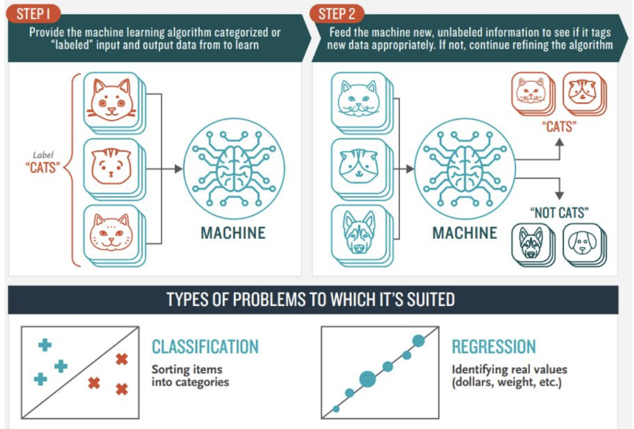
Supervised Learning

Slide 11
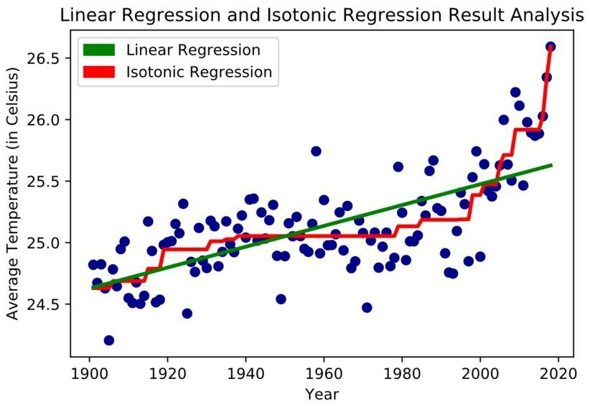
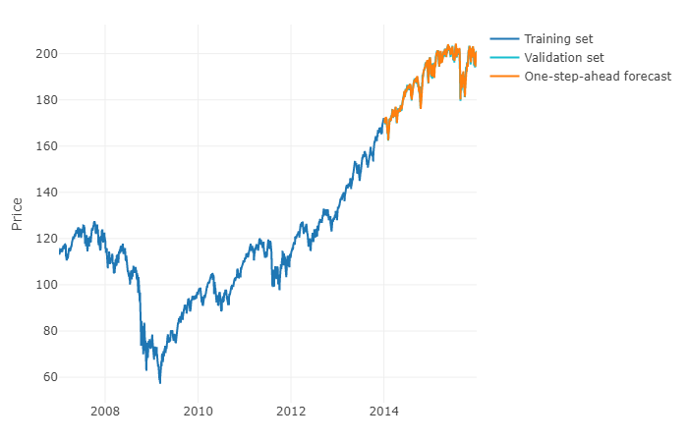
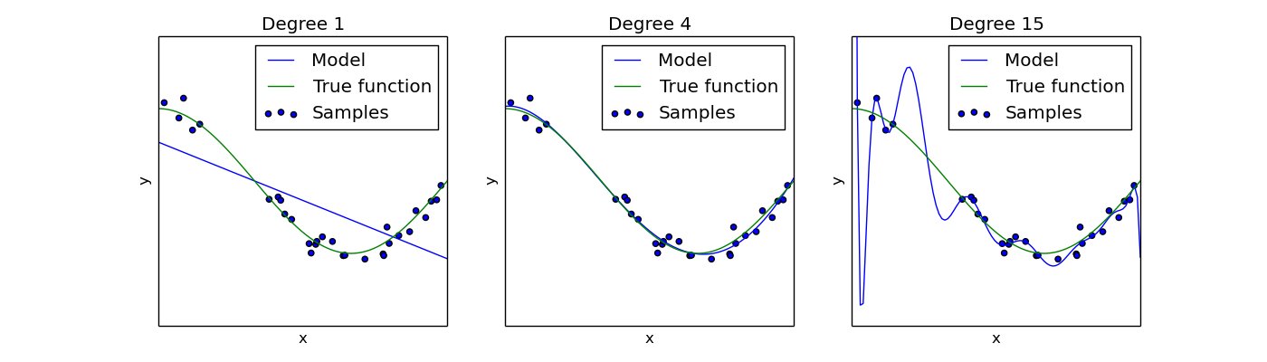
Regression

Slide 12
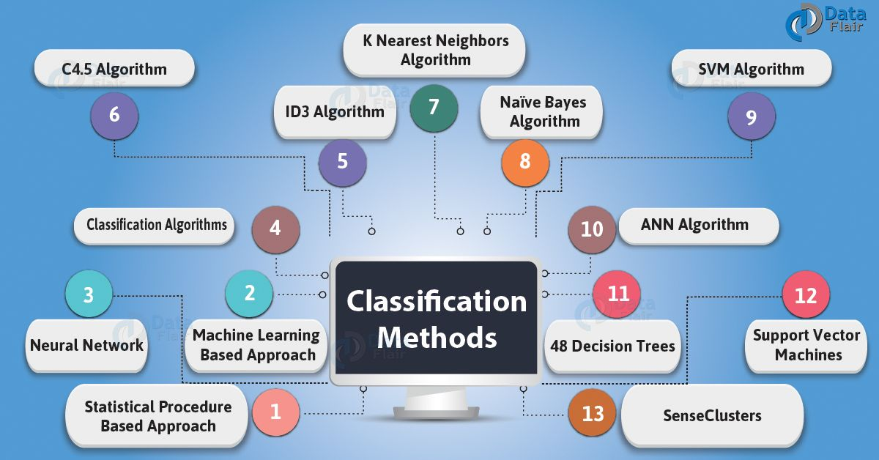
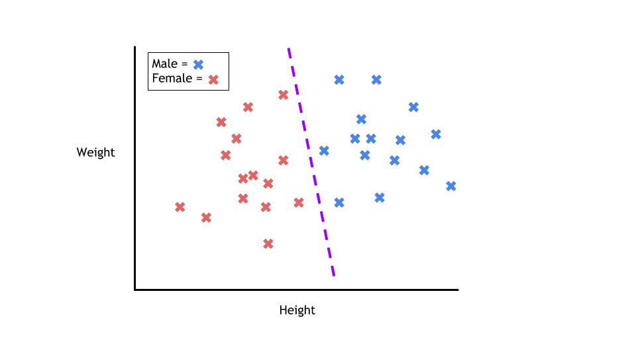
Classification

Slide 13
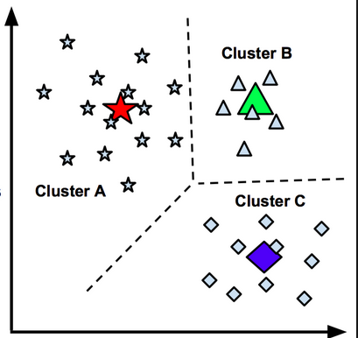
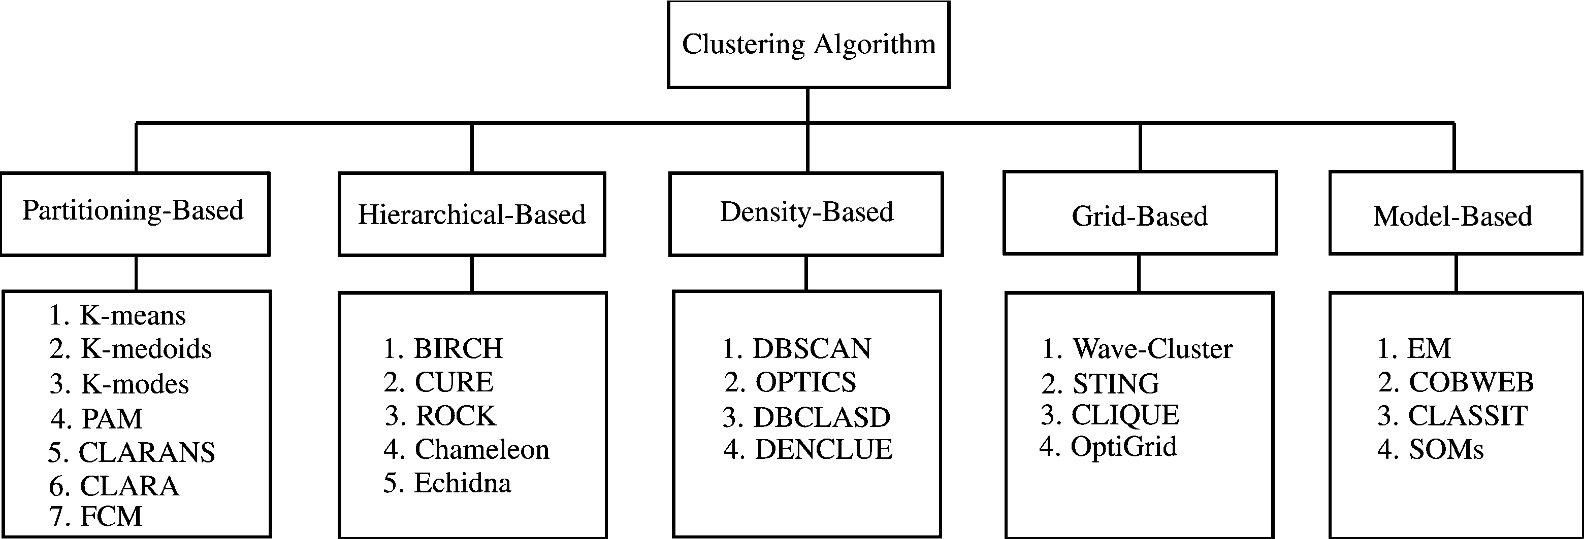
Clustering

Slide 14
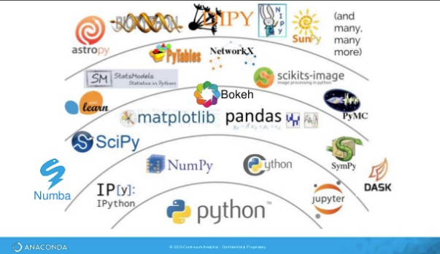
Data Science Libraries

Slide 15
Data Science Libraries
Data 2

Slide 16
Data Representation
Label
Features
One data sample

Slide 17
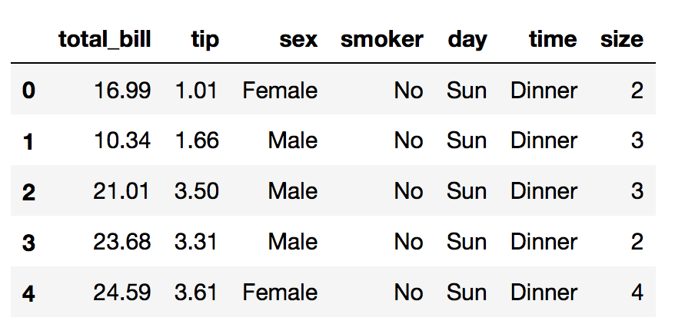
Example of Regression Data
Predict total bill of a customer.

Slide 18
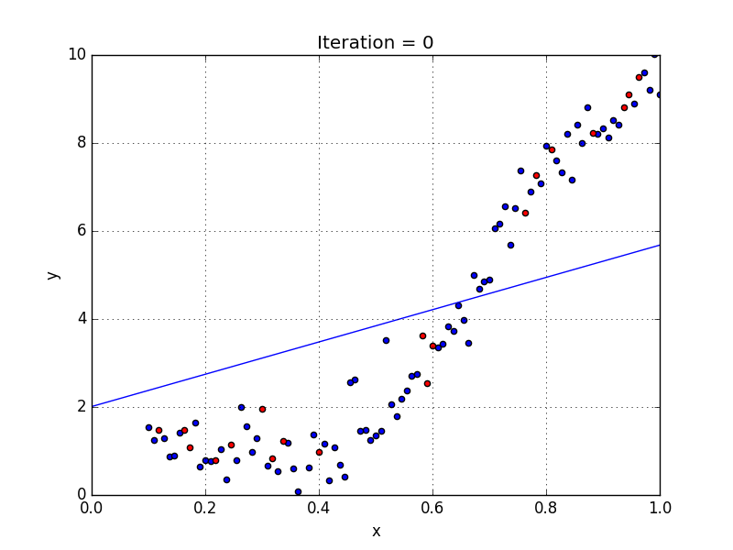
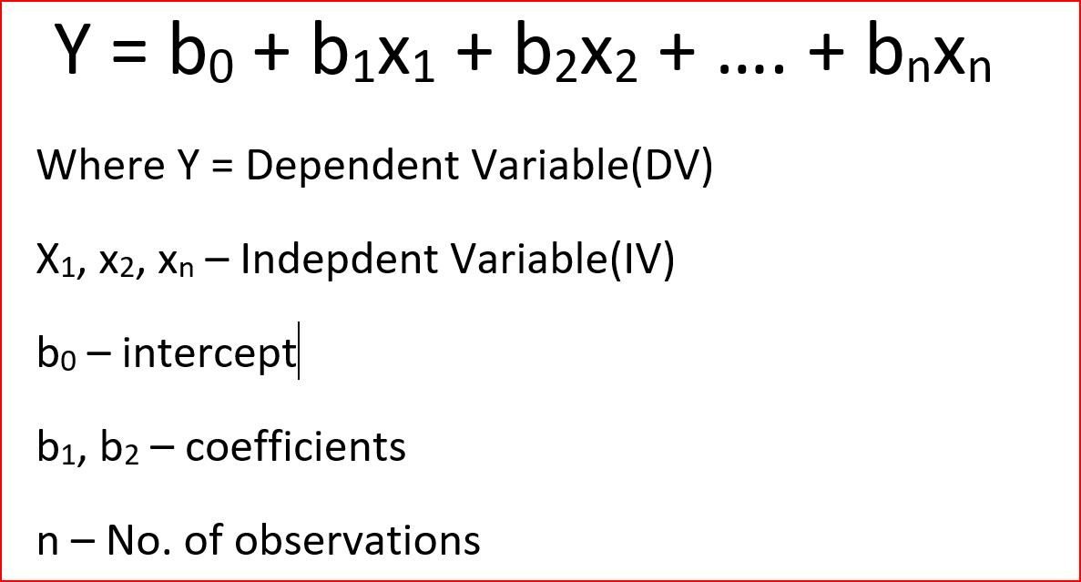
Linear Regression Model

Slide 19
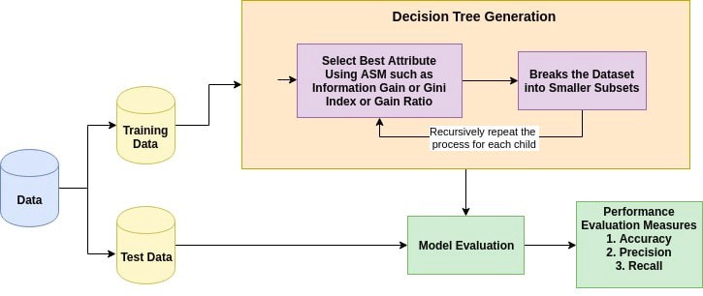
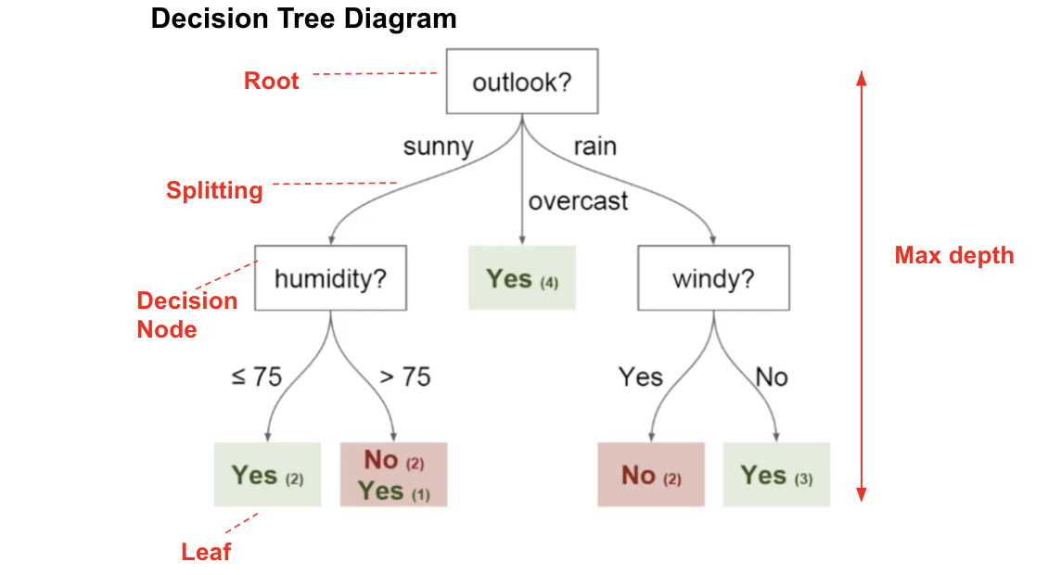
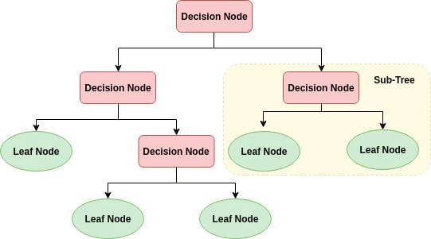
Decision Tree Classifier

Slide 20
Decision Tree Contd..
Root Node (Top Decision Node): It represents the entire population or sample and this further gets divided into two or more homogeneous sets.
Splitting: It is a process of dividing a node into two or more sub-nodes.
Decision Node: When a sub-node splits into further sub-nodes, then it is called a decision node.
Leaf/ Terminal Node: Nodes with no children (no further split) is called Leaf or Terminal node.
Pruning: When we reduce the size of decision trees by removing nodes (opposite of Splitting), the process is called pruning.
Branch / Sub-Tree: A sub section of the decision tree is called branch or sub-tree.
Parent and Child Node: A node, which is divided into sub-nodes is called a parent node of sub-nodes whereas sub-nodes are the child of a parent node.

Slide 21
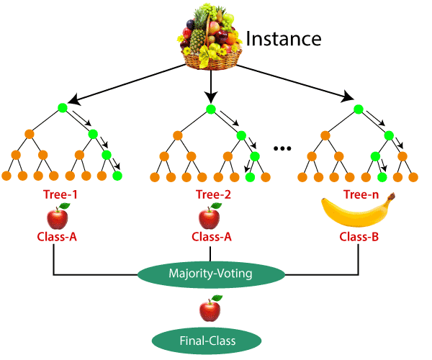
Random Forest
Step 1 − First, start with the selection of random samples from a given dataset.
Step 2 − Next, this algorithm will construct a decision tree for every sample. Then it will get the prediction result from every decision tree.
Step 3 − In this step, voting will be performed for every predicted result.
Step 4 − At last, select the most voted prediction result as the final prediction result.

Slide 22
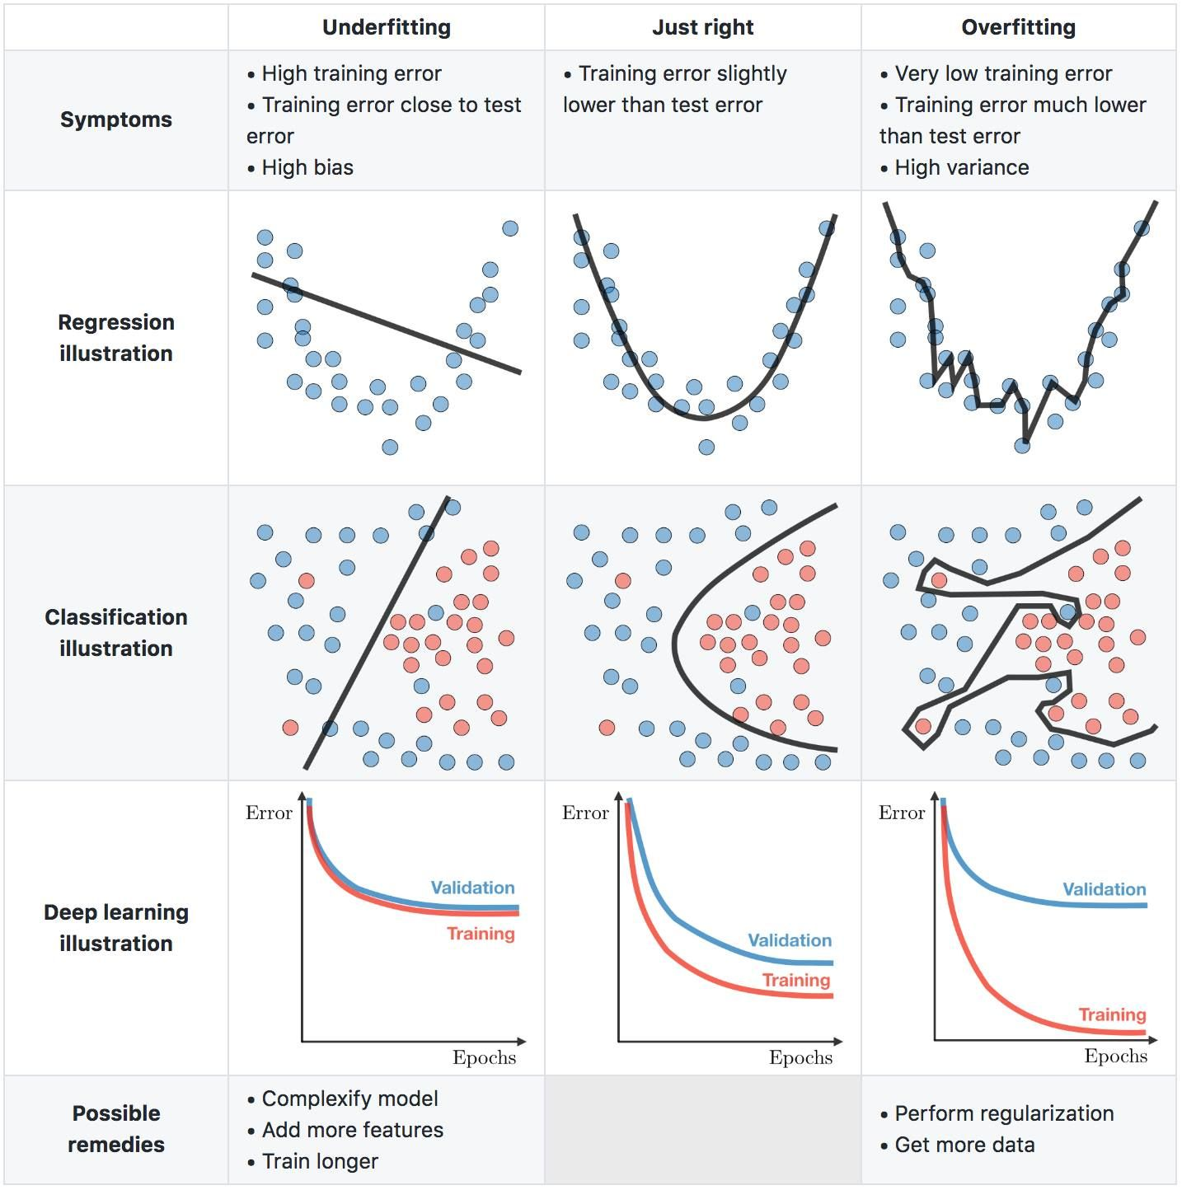
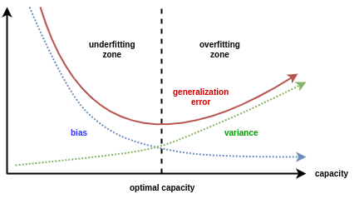
Bias vs Variance Tradeoff

Slide 23
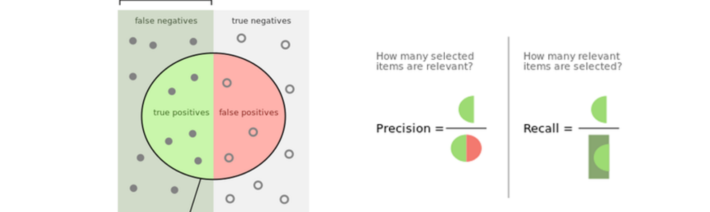
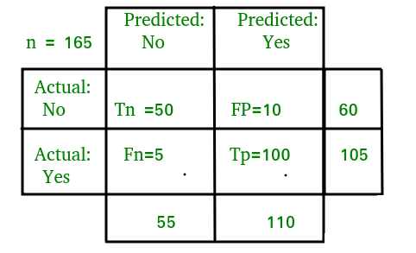
Performance Evaluation

Slide 24



Lets do some real work now
@account

